Slide 1
Test Cases
In the following slides, few well known multimodal functions and NP problems are outlined as possible applications for BIC algorithms

Slide 2
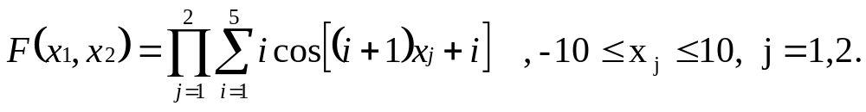
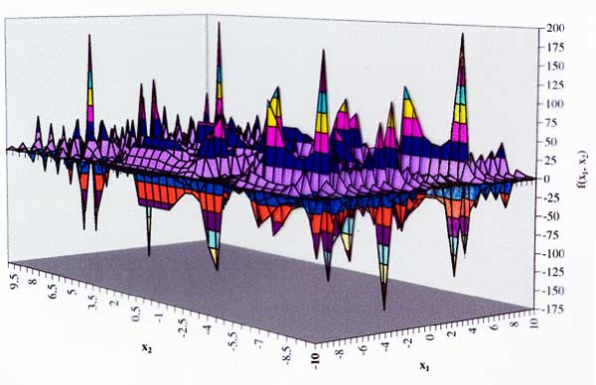
The schubert Function

Slide 3
The Timetabling Problem (TTP)
Timetabling is a schedule of resources (e.g. teacher, room, class) over a fixed period of time, often to achieve a certain result subject to a set of (soft and hard) constraints.
Thus, if we want to solve this scheduling manually ,we need several days or weeks

Slide 4
Terminologies of TTP
Resources: some events arranged totally without conflict
Periods of time: is a specific range of time given by organization to schedule resources within it
Hard constraints are constraints, in which, in any working timetable, there will be no breaches
Soft constraints are constraints which may be broken, but in which breaches must be minimized
Feasibility a timetable is feasible if it satisfies all its hard constraints
Timetable A description of the movement and grouping of resources over time

Slide 5
TTP Types
Industrial Timetabling problem
Educational Timetabling Problem
    School Timetabling Problem (STTP)
    Lecture Timetabling Problem (LTTP)
    Exam timetabling Problem (ETTP)

Slide 6
Coding the Chromosomes
In timetabling terms, we try to assign (Students, Teachers, Rooms, and Classes) to periods of time under the constraints without conflict. In this case we need an array with five dimensions to represent the chromosome

Slide 7
We suggest some assumptions to reduce the complexity of the chromosome representation:
We can eliminate the term (student) from the schedule because the student books the class after ordering all other terms in timetabling. There are also several sections of the class available in different periods of time. Clashes occurring in this case are rare, and if they occur we can solve them during the registration process

Slide 8
the terms Rooms and Period are assigned together based on room availability. It should be noted that the user will input the period available for Rooms when he inputs data. Moreover, we have eliminated some hard constraints.
    We can assign class and Teacher to a RoomPeriod, and so we need a three dimension array in the representation process

Slide 9
Coding the Chromosomes Cont.
The remaining two terms (Teachers and Classes) are assigned together with all different probabilities and put to pool
Teacher 1
Class 1
Teacher 2
Class 1
Teacher 3
Class 1
Teacher M
Class 1
…
Teacher 1
Class 2
Teacher 2
Class 2
Teacher 3
Class 2
Teacher M
Class 2
…
…
…
…
…
…
Teacher 1
Class N
Teacher 2
Class N
Teacher 3
Class N
Teacher M
Class N
…
Pool (all chances of specific teachers are assigned to specific classes)

Slide 10
Each chromosome is divided into three parts related to all terms. We choose a vector representation to represent a chromosome with the length of (number of period*room availability) and rank it with class number (the length of any chromosome equals the number of classes) for example:
RoomPeriod11 |  | RoomPeriod12 |  | … | Room Period 1N |  | Room Period 21 |  | Room Period 22 |  | … | Room Period NM
1 | 4 | 1 | 3 | … | 12 | 10 | 12 | 22 | 11 | 10 |  | 43 | 32
Classes and teachers Label selected from the pool

